Slide 1
Python web crawler (scraping)
kuo-chen Li

Slide 2

What is web crawler
A Web crawler, sometimes called a spider or spiderbot and often shortened to crawler, is an Internet botthat systematically browses the World Wide Web, typically for the purpose of Web indexing (web spidering).

Slide 3
Web scraping
Web scraping, web harvesting, or web data extraction is data scraping used for extracting data from websites.^{[1]} Web scraping software may access the World Wide Web directly using the Hypertext Transfer Protocol, or through a web browser.

Slide 4
packages you need
requests
Requests allows you to send organic, grass-fed HTTP/1.1 requests, without the need for manual labor. There's no need to manually add query strings to your URLs, or to form-encode your POST data.
BeautifulSoup (bs4)
Beautiful Soup is a library that makes it easy to scrape information from web pages. It sits atop an HTML or XML parser, providing Pythonic idioms for iterating, searching, and modifying the parse tree.

Slide 5
Step 1. Crawl the web, send http request
import requests
from bs4 import BeautifulSoup
# Specify the URL of the BBC News website
url = 'https://www.bbc.com/news'
# Make a GET request to the website
response = requests.get(url)
print(response.text[:500])

Slide 6
HTTP requests
S.N. | Method and Description
1 | GET The GET method is used to retrieve information from the given server using a given URI. Requests using GET should only retrieve data and should have no other effect on the data.
2 | HEAD Same as GET, but it transfers the status line and the header section only.
3 | POST A POST request is used to send data to the server, for example, customer information, file upload, etc. using HTML forms.
4 | PUT Replaces all the current representations of the target resource with the uploaded content.

Slide 7
status code 200
# Check if the request was successful (status code 200)
if response.status_code == 200:
# Parse the HTML content of the webpage using BeautifulSoup
soup = BeautifulSoup(response.content, 'html.parser')
else:
print(f'Error: Failed to retrieve webpage. Status code: {response.status_code}')

Slide 8
Step 2. Parse the html
soup = BeautifulSoup(response.content, 'html.parser')
print(type(soup))
print(soup.title.text)

Slide 9
Understand HTML
<!DOCTYPE html>
<html>
<head>
<title>Page Title</title>
</head>
<body>
<h1>This is a Heading</h1>
<p>This is a paragraph.</p>
</body>
</html>
This is a Heading
This is a paragraph.

Slide 10
Step 3 Find the target information
headlines = soup.find_all('h3', class_='gs-c-promo-heading__title')[:5]
for headline in headlines:
print(headline.text.strip())

Slide 11
Step 4. Get detail information for each segment
headlines = soup.find_all('div', class_='gs-c-promo-body')[:5]
for headline in headlines:
link=headline.find('a', class_='gs-c-promo-heading')
if link != None:
print(link['href'])

Slide 12
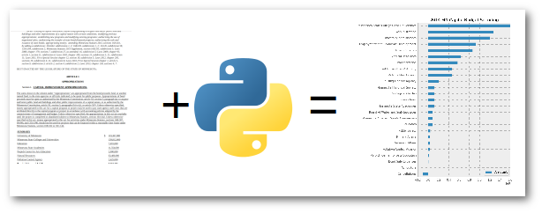
More example
Link

